Slide 1
Hospital Performance Dashboard Analysis
- Manikrao

Slide 2
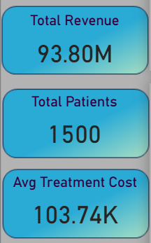
KPIs Overview
Total Revenue: 93.80M
Total Patients: 1500
Avg Treatment Cost: 103.74k

Slide 3
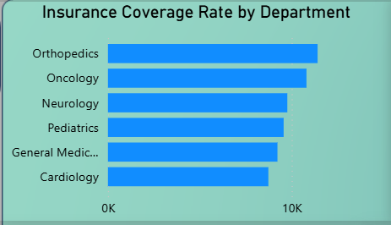
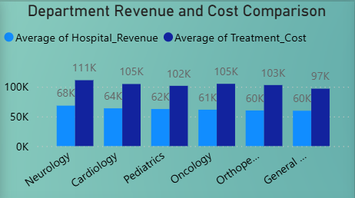
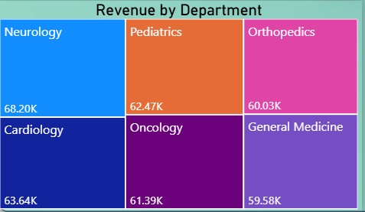
Department Performance

Slide 4
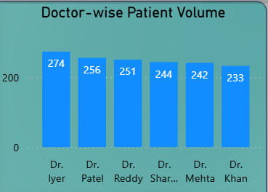
Doctor Workload
Dr. Iyer is the highest workload doctor.
Patient distribution across doctors is almost balanced.

Slide 5
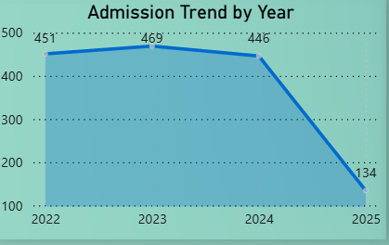
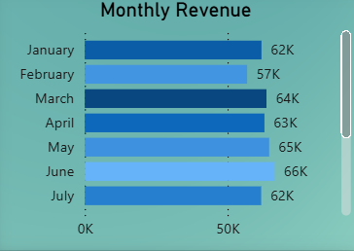
Time Trends
2023 was our peak year, the dip cause in 2025 is because we have only 4 months data.
Monthly revenue shows seasonal variation, with
Sep(69k)–June(66k)being the highest revenue months and Feb(57k)-Nov(57k) lowest revenue months.

Slide 6
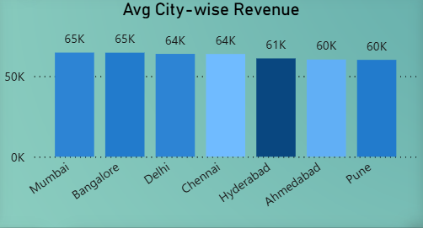
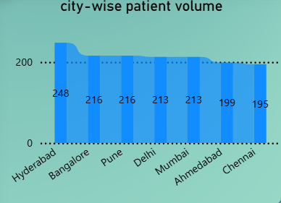
City Analysis
Mumbai & Bangalore are the high revenue cities followed by others.
Hyderabad city has the highest patient volume followed by Bangalore and Pune.

Slide 7
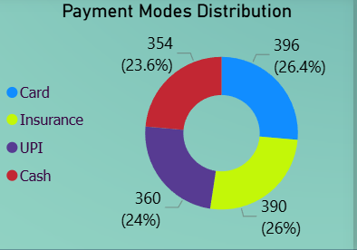
Payment Behaviour
Card and Insurance are the most used payment modes.

Slide 8
Insights & Recommendations
Increase insurance partnerships in low-coverage departments.
Optimize pricing in Oncology due to high-cost vs revenue gap.
Allocate more staff to high-volume doctors and cities.
Focus marketing in high-revenue cities like Bangalore and Mumbai.
Promote digital payments to reduce cash handling costs.

Slide 9
Thank you

